Slide 1
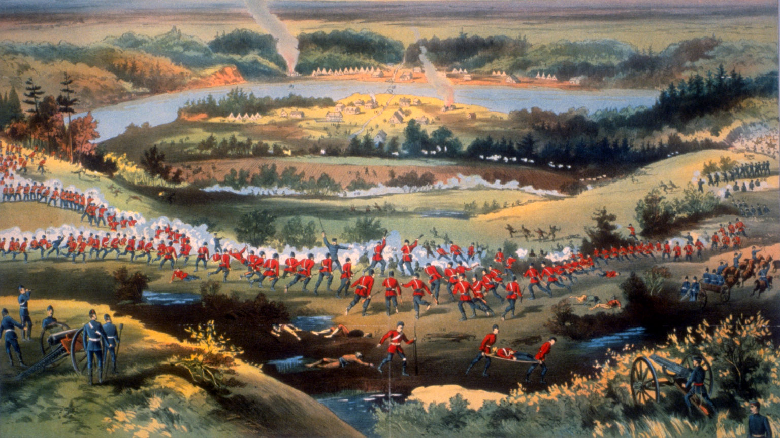
Louis Riel & the Northwest Rebellion
Mr. Mann – Canadian History 12
February 2nd 2020

Slide 2
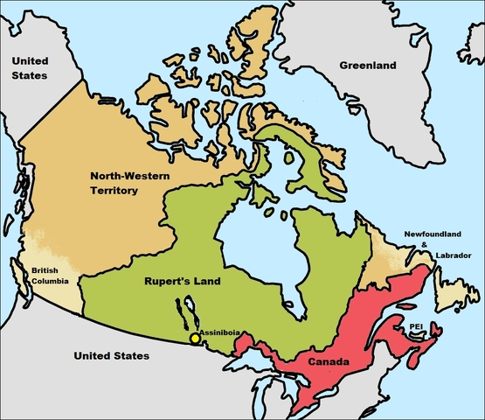
Rupert’s Land
In 1670 King Charles II of England issued a Royal Charter in which the Hudson’s Bay Company, under the governorship of the king's cousin Prince Rupert of the Rhine, of all land in Canada that was not already now possessed by any of “our Subjects, or by the Subjects of any other Christian Prince or State.” And in 1821, the Hudson’s Bay Company merged with the North West Company.
In 1868, the Parliament of the United Kingdom of Great Britain authorized The Rupert's Land Act, which transferred the ownership of Rupert's Land from the Hudson's Bay Company to the Dominion of Canada.

Slide 3
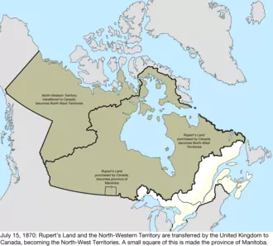
The Rupert's Land Act (1868)
Once the Canadian government claimed the land from the Hudson Bay Company they began to set up Members of Parliament.
The Rupert's Land Act (1868) caused severe controversy in the area of the Red River Colony (Manitoba).
In the eyes of the British Crown and the Canadian government, the land was seen to be owned by the Hudson Bay Company, even though Indigenous people and Métis people lived there
In 1869, William McDougall (the Lieutenant Governor of Rupert's Land and the North-West Territory), set out to Red River accompanied by many administrative officers.
The Métis, who were not consulted upon these government actions, were distressed and concerned about the situation. Once the Métis became aware of this new government attempting to control their territory, they created a provisional government of their own.

Slide 4
Time To Do A Little Reading:
In addition to reading the text, please consider the following while reading:
Origin: What kind and type of source is it? Who created it?
Perspective: From what point of view is the source created?
Context: When was the source created? What historical events happened at this time that are important to the creation of this source?
Motive: Who was the intended audience of the source? For what purpose was this source made?

Slide 5
Time To Do A Little More Reading:
In addition to reading/viewing please consider the following:
Origin: What kind and type of source is it? Who created it?
Perspective: From what point of view is the source created?
Context: When was the source created? What historical events happened at this time that are important to the creation of this source?
Motive: Who was the intended audience of the source? For what purpose was this source made?
Reliability: How does this source corroborate or conflict with information from another source? How trustworthy is the source?

Slide 6
Essential Questions For Today
Who was Louis Riel and what was the Northwest Rebellion?
Why does Riel's memory appear to arouse controversy?
Is Riel a hero, a traitor, a freedom fighter, or a terrorist?
Does anything regarding today’s learning experience relate to the present?

